Slide 1
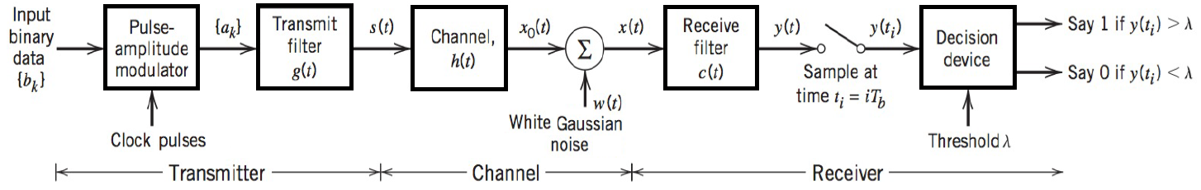
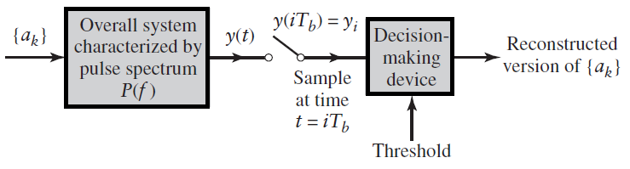
Binary Base-band data transmission System

Slide 2
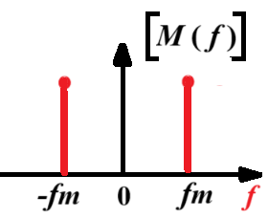
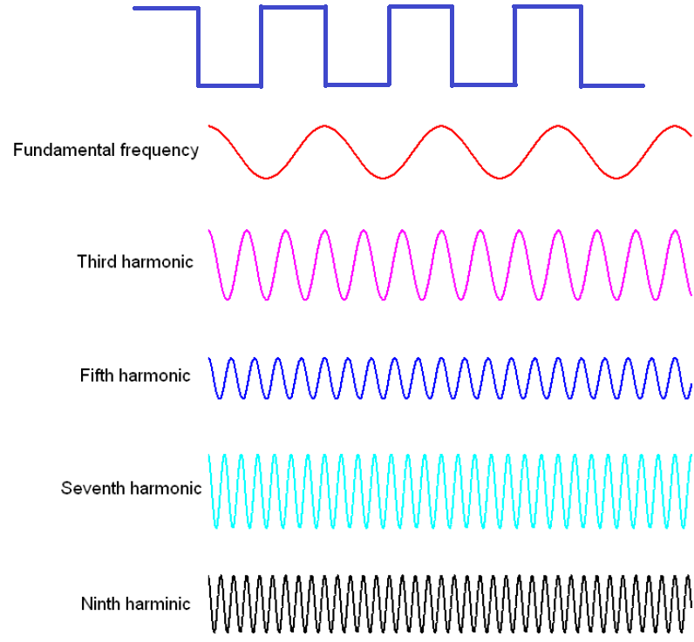
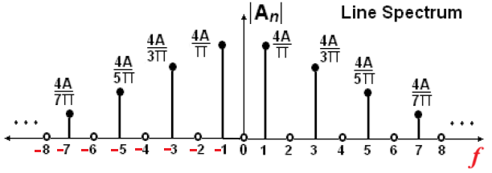
Bandwidth of Digital Pulse Signals

Slide 3
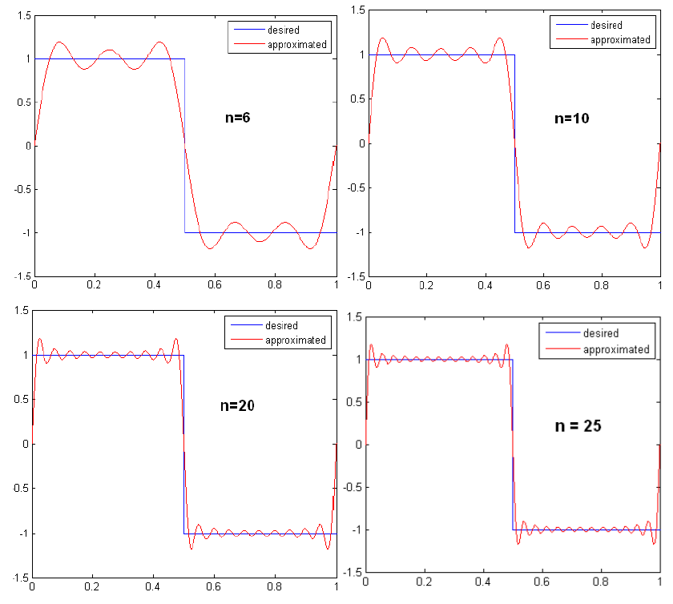

Slide 4
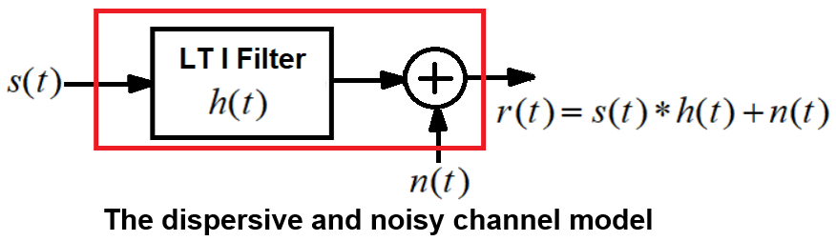
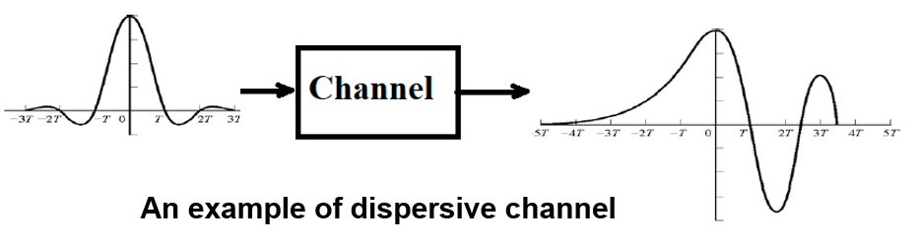
Dispersive and Noisy Channel
A dispersive channel refers to a type of communication channel where
signals, particularly high-frequency signals, experience distortion due to low bandwidth of the channel and
varying propagation delays for different frequency components.

Slide 5
The transmission of digital data over a baseband channel
Digital data have a broad spectrum with a significant low-frequency content.
Baseband transmission of digital data therefore requires the use of a low-pass channel with a bandwidth large enough to accommodate the essential frequency content of the data stream.

Slide 6
The transmission of digital data over a baseband channel
Typically, however, the channel is dispersive in that its frequency response deviates from that of an ideal low-pass filter.
The result of data transmission over such a channel is that each received pulse is affected somewhat by adjacent pulses, thereby giving rise to a common form of interference called inter Symbol interference (ISI).
Inter symbol interference is a major source of bit errors in the reconstructed data stream at the receiver. (SNR in Analog Communication)
To correct for bit errors, control has to be exercised over the pulse shape in the overall system.

Slide 7
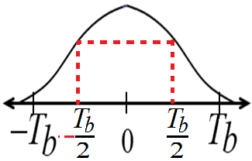
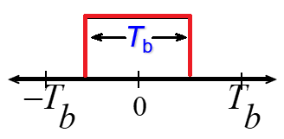
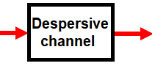
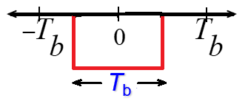
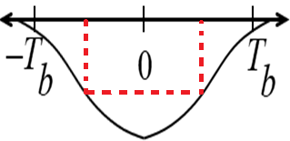
Inter Symbol Interference
Inter Symbol interference (ISI) occurs when a pulse spreads out in such a way that it interferes with adjacent pulses at the sample instant.
Example: assume polar NRZ line code. The channel outputs are shown as spreaded (width T_{b} becomes 2T_{b}) pulses shown (Spreading due to bandlimited channel characteristics).
Channel Output
Pulse width T_{b}
Channel Input Pulse width T_{b}
Data 1
Data 0

Slide 8
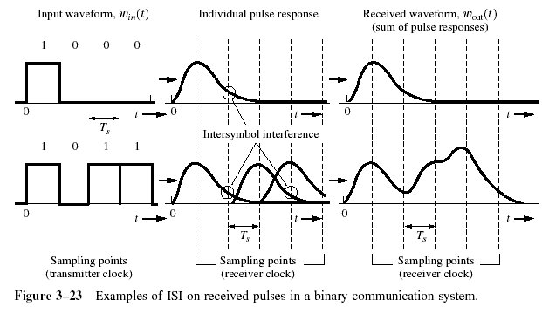
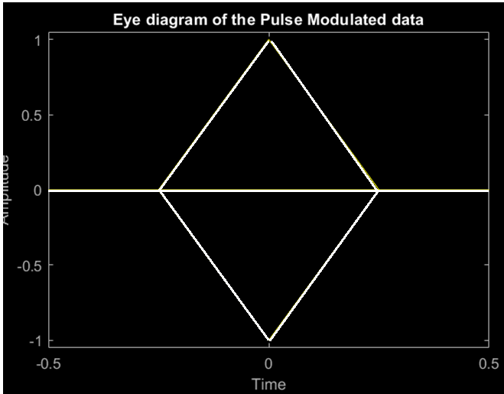
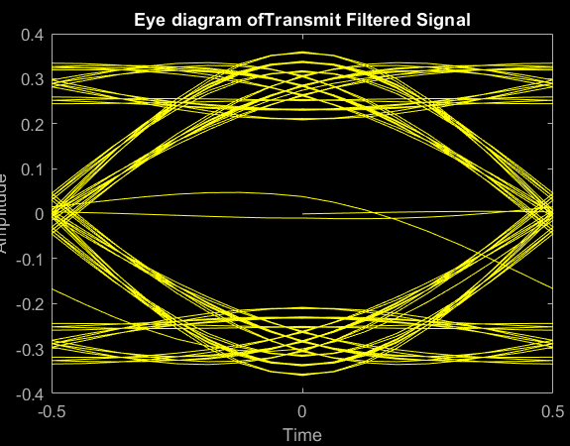
ISI
If the rectangular multilevel pulses are filtered improperly as they pass through a communications system, they will spread in time, and the pulse for each symbol may be smeared into adjacent time slots and cause Intersymbol Interference.
Eye diagrams

Slide 9
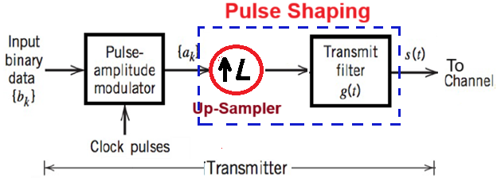
Pulse Shaping:
Pulse Shaping is the process of changing the waveform of transmitted pulses to the desired shape suitable for transmission and reception of digital communication.
Pulse shaping occurs after line coding and modulation.
In RF communication, pulse shaping is essential in both transmitter and receiver for making the signal fit in its frequency band,
The Pulse shaping filtered signal will limit the effective bandwidth of the transmission.
By Pulse Shaping filtering the transmitted pulses, the inter symbol interference (ISI) caused by the channel can be kept in control.
To control the bit errors by eliminating ISI.
The waveform or pulse is usually up-sampled to overcome the channel bandwidth restriction.

Slide 10
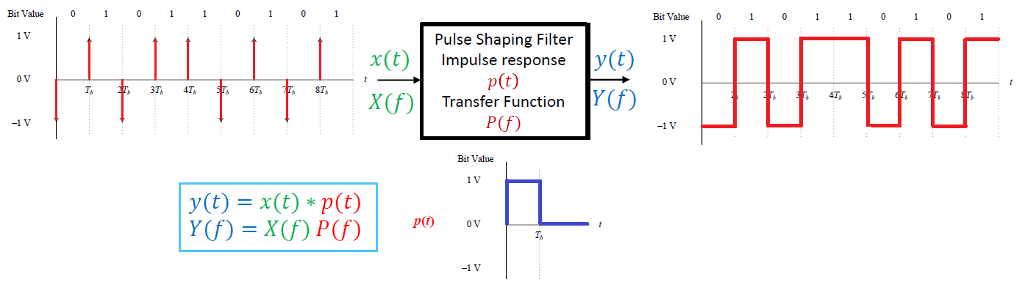
Pulse Shaping:

Slide 11
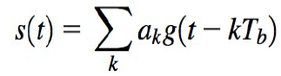

ISI in signal transmission
The baseband pulse amplitude modulation (PAM) communication system is shown below:
The baseband signal at the output of the transmitting filter may be expressed as

Slide 12
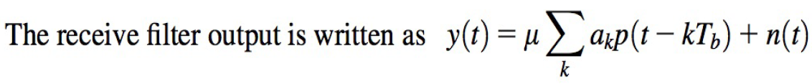
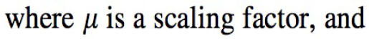
ISI in signal transmission

Slide 13
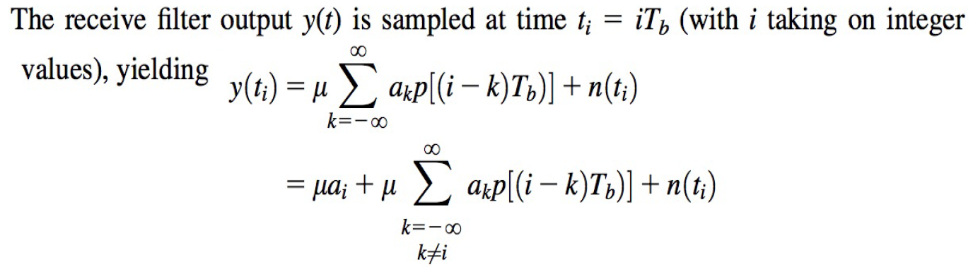
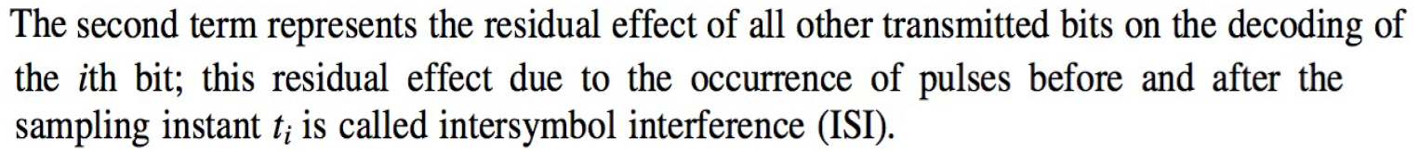

Slide 14
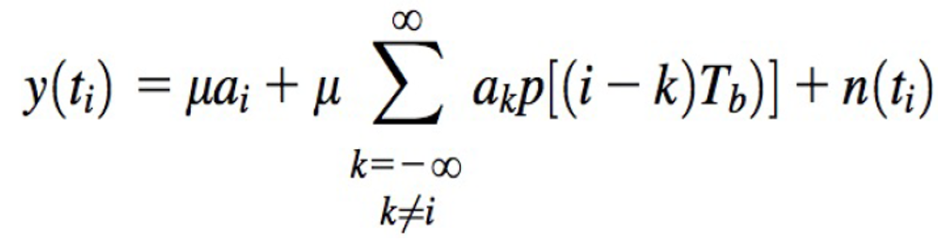
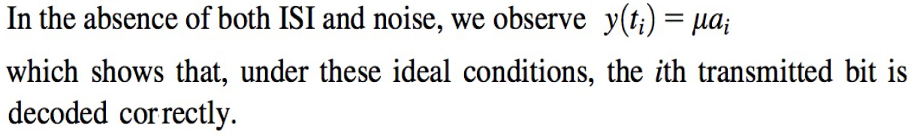
Therefore, in the design of the transmit and receive filters, the objective is to minimize the effects of noise and ISI and thereby deliver the digital data to its destination with the smallest error rate possible.

Slide 15
ISI Elimination Techniques
It is important to note that pulse amplitudes can be detected correctly despite pulse spreading (or overlapping), if there is no ISI at the decision-making instants.
This can be accomplished by a properly shaped band limited pulse signals.
To eliminate the effect of ISI, Nyquist proposed the following criteria for pulse shaping.
Ideal Nyquist Criterion: Sinc Pulse.
Practical filter: Raised Cosine Filter

Slide 16
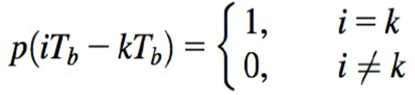
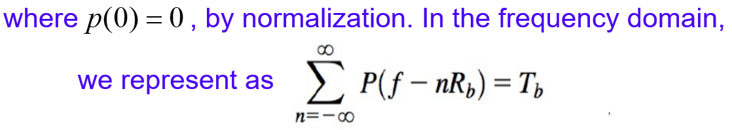
Ideal Nyquist Criterion: Sinc Pulse
This equation is referred to as Nyquist criterion for distortion-less baseband transmission in the absence of noise.
The simplest form of that satisfies the Nyquist criterion is the rectangular function

Slide 17
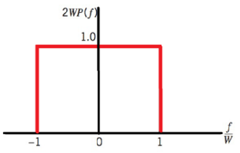
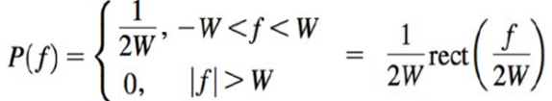
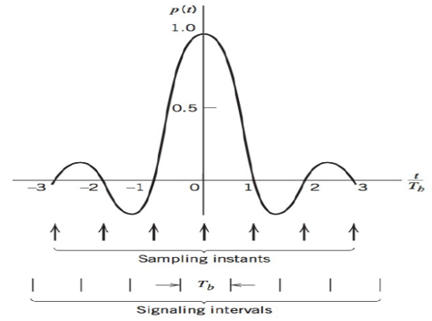

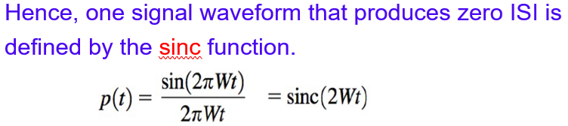
Ideal Nyquist Criterion: Sinc Pulse
The simplest form of that satisfies the Nyquist criterion is the rectangular function

Slide 18
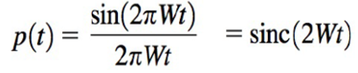

Slide 19
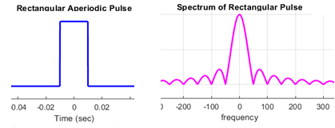
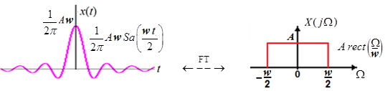
Practical difficulties:

Slide 20
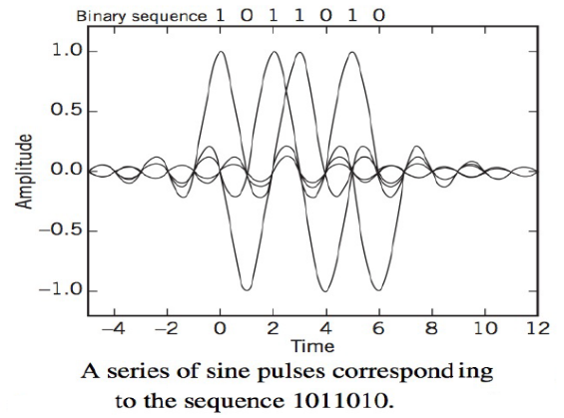
Two practical difficulties:
An example for ISI elimination with data 1011010 is shown below:

Slide 21
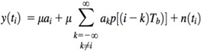
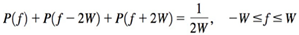
Practical Filters: Raised Cosine Filters
We may overcome the practical difficulties encountered with the ideal Nyquist channel by extending the bandwidth from the minimum value W = Rb/2 to an adjustable value between W and 2W.
We now design a practical filter by specifying the frequency function P(f) by retaining three terms from
as given by

Slide 22
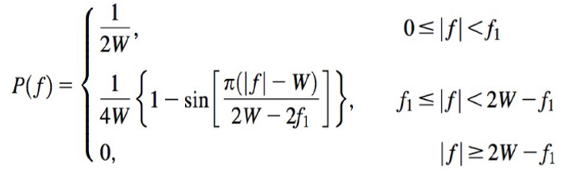
Raised Cosine Filters
A particular form of P( f ) that embodies many desirable features is provided by a raised cosine spectrum. This frequency characteristic consists of a flat portion and a roll-off portion that has a sinusoidal form, as follows:

Slide 23
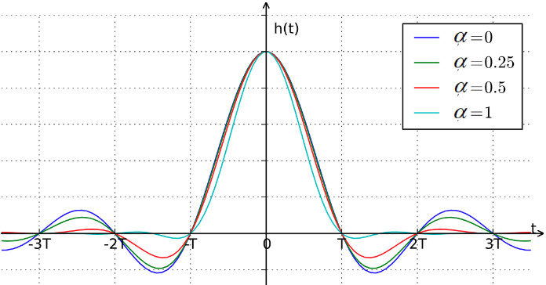
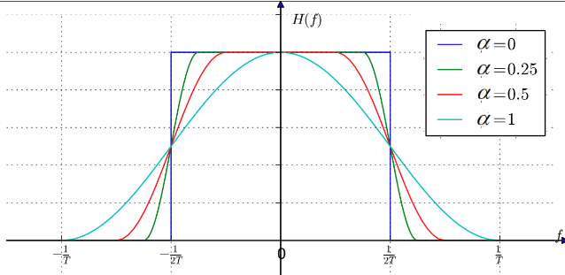
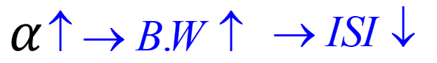
The time response and frequency responses for different roll-off factors, are illustrated below.
This time response exhibits two interesting properties:
At t = ±Tb/ 2 = ± (1/4)W, we have p(t) = 0.5; that is, the pulse width measured at half amplitude is exactly equal to the bit duration Tb.
There are zero crossings at t = ±3Tbl2, ±5Tb/2,... in addition to the usual zero at the sampling times t = ±Tb, ±2Tb,....
These two properties are extremely useful in extracting a timing signal from the received signal for the purpose of synchronization.

Slide 24
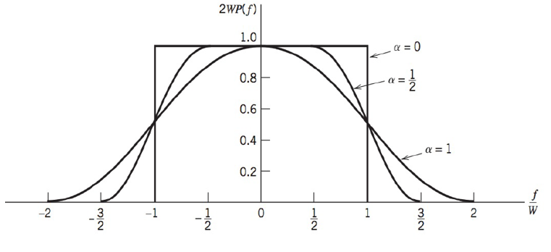
Raised Cosine Pulse

Slide 25
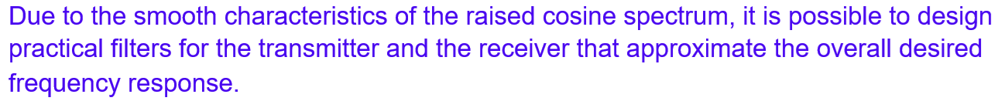

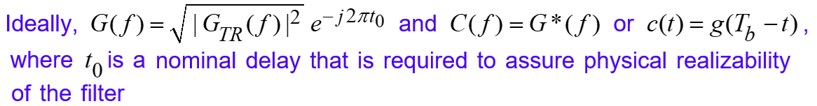
Transmit and Receive Filters

Slide 26
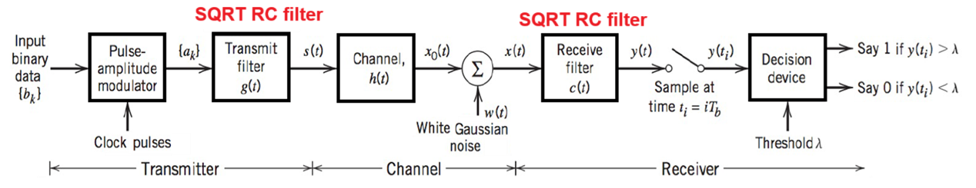
Thus, the overall raised cosine spectral characteristic is split evenly between the transmitting filter and the receiving filter. Hence square root raised cosine filter is used as a transmit filter at the transmitter side and receive filter at receiver side as shown below.

Slide 27
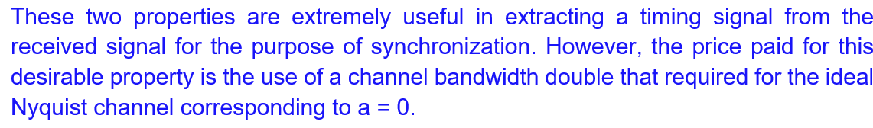
Properties of Raised Cosine Pulse

Slide 28
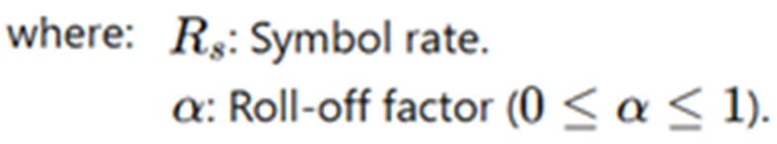
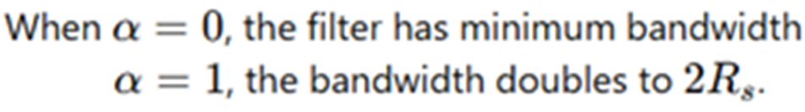
Bandwidth for Raised Cosine Nyquist Filtering
The bandwidth of a Raised-cosine (RC) rolloff pulse shape is a function of the bit rate and the rolloff factor:
Or solving for bit rate yields the expression:

Slide 29
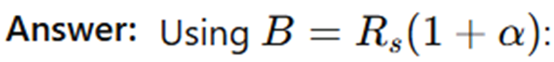
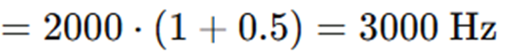


Problems on Bandwidth calculations:
Calculate the bandwidth of a Raised Cosine filter with a symbol rate of 2 kHz and a roll-off factor of 0.5.
A channel has a symbol rate of 5 kHz. Develop a Raised Cosine filter and find the minimum and maximum bandwidth for a Raised Cosine filter.

Slide 30
A system uses SRRC filters at both the transmitter and receiver with α=0.25 and a symbol rate of 8 kHz. Calculate the system bandwidth.
Ans: 10 kHz
A Raised Cosine filter has α=0.35 and a symbol rate of 4 kHz. Determine the bandwidth required.
Ans: 5.4 kHz
Design a system with zero ISI for a symbol rate of 20 kHz using a filter with α=0.5. Calculate the required bandwidth.
Ans: 30 kHz

Slide 31
End

